Slide 1
Reading and Phonics at HCJS
Monday 13th October 2025

Slide 2


National Reading Expectations
Children at risk of reading failure
Pupils who fail to learn to read early on start to dislike reading. The guidance emphasises that pupils need to keep up with their peers rather than be helped to catch up later, at a point when learning in the wider curriculum depends so much on literacy. Where pupils make insufficient progress, extra efforts should be made to provide them with extra practice and support from the beginning.

Slide 3

National Reading Expectations
In evaluating primary schools’ teaching of reading, Ofsted’s inspectors pay particular attention to pupils who are reading below what is expected for their age.
At secondary level, Ofsted expects that ‘all pupils, particularly disadvantaged pupils and those with special educational needs and disabilities (SEND) … are able to read to an age-appropriate level and fluency (if not, they will be incapable of accessing the rest of the curriculum, and they will fall rapidly behind their peers)’.

Slide 4
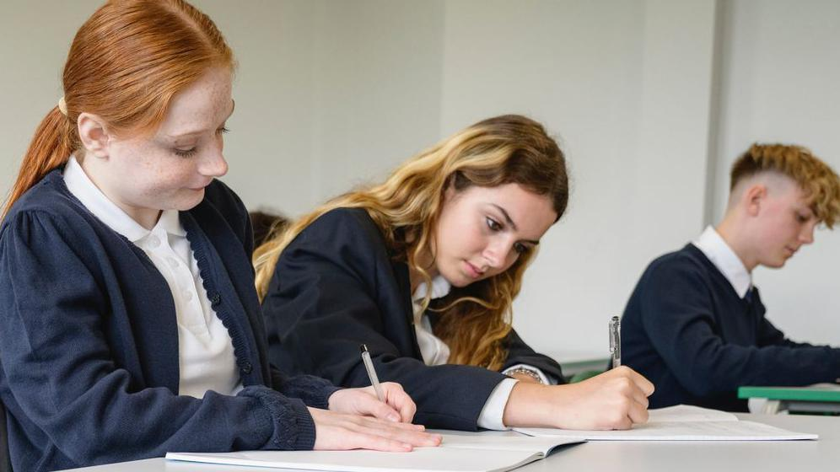
BBC Report - 26th September 2025
Year 8 pupils to sit compulsory reading tests under new plans
Notes:
Due to these concerns…

Slide 5
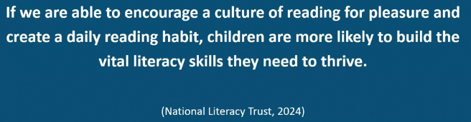
Our aim…
Notes:
At HCJS, we begin with ensuring the children’s understanding of phonics

Slide 6
HCJS Ofsted Report for Reading - July 2025
There is a sharp focus on reading in the school. Ongoing checks mean the school quickly identifies those who need extra help with reading. Staff are well trained to deliver the phonics programme effectively. Daily support enables pupils, particularly the most disadvantaged, to become confident and fluent readers. Pupils develop a love of reading as they move through the school. Reading lessons engage pupils in high-quality and challenging texts. Regular visits from their favourite authors inspire pupils to read often for pleasure.

Slide 7
A love of reading is the biggest indicator of future academic success.
OECD (The Organisation for Economic Co-operation and Development)
Notes:
Slide purpose:
To share the link that research has established between loving reading and being successful academically
Suggested script:
Let's start our session with a quote from the Organisation for Economic Co-operation and Development ...
Read the quote.
This quote reminds us of the importance not just of teaching children to read, but also of teaching them to love reading.
Today, we're going to talk about phonics, but we always see phonics as the route into reading and a love of reading as the ultimate goal of phonics teaching.

Slide 8
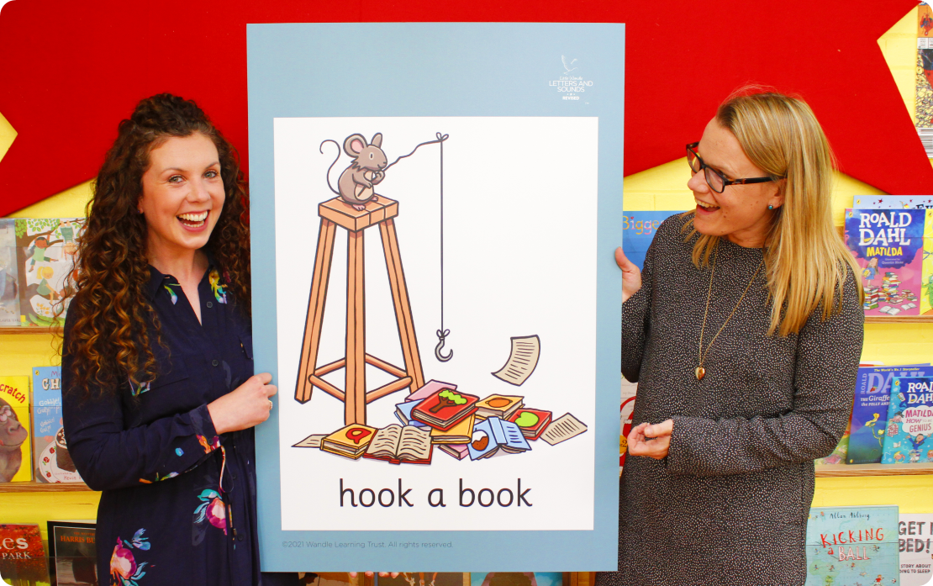
Little Wandle Letters and Sounds Revised
Our school has chosen Little Wandle
Letters and Sounds Revised as our
systematic, synthetic phonics (SSP)
programme to teach early reading.
We use Little Wandle Rapid Catch-up Programme to support pupils not currently reading at age-related expectations in Year 3 and above. The programme has a fast pace, so the children can access the curriculum and enjoy reading as soon as possible.
Notes:
Slide purpose:
To inform that all schools must teach phonics but explain your school's choice of SSP
Suggested script:
Read the slide.
However, we recognise that, for a range reasons, some children will need support with phonics beyond Year 1 to support them to become skilled, fluent readers who enjoy books and other texts.

Slide 9
Our Screening Process
As the children enter our school in Yr3, they are screened on their reading fluency and phonics understanding.
This process quickly indicates to us our:
Free readers
Children that need help to become more fluent readers.
Children who need to take part in our Rapid catch up programme.
Our baseline is a score of 34 or less in their KS1 phonics screening.

Slide 10
Phonics is:
making connections between the sounds of our spoken words and the letters that are used to write them down.
Notes:
Slide purpose:
To give a simple definition of phonics
Suggested script:
Read the slide.
It sounds complicated but it really isn’t!
Let's review some of the important words that will help you understand phonics ...

Slide 11
Terminology
phoneme
split vowel digraph
grapheme
blend
digraph
segment
trigraph
Notes:
Slide purpose:
To give simple definitions of key terminology
Suggested script:
Review what each word means – use the Glossary to help.

Slide 12
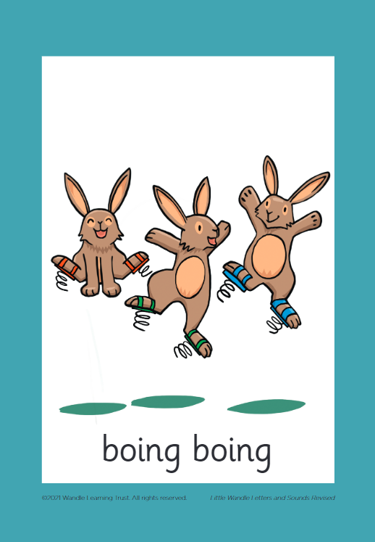



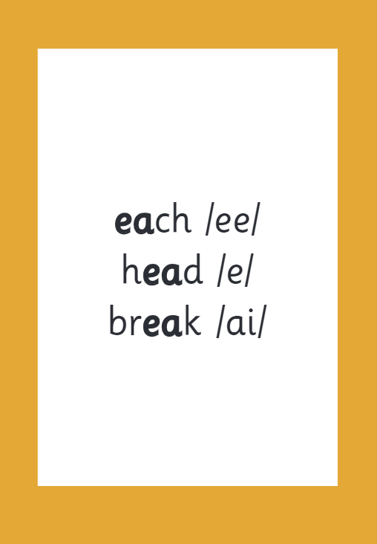

How we make learning stick
Notes:
Slide purpose:
To provide an overview of the programme’s efficacy
Suggested script:
There are specific resources for the Little Wandle Rapid Catch-up programme which the children will be very familiar with.
Each sound that we teach to begin with has either a mnemonic designed to aid children's memory (like the astronaut that you can see here) or a phrase like ‘boing-boing’ for ‘oi’. This helps the children recognise and remember the graphemes.
Every time we teach a new sound, we also read words during the Rapid Catch-up lesson that contain that new sound so that the children practise what they have learned.
We then go on to reading a sentence containing some of those words.

Slide 13
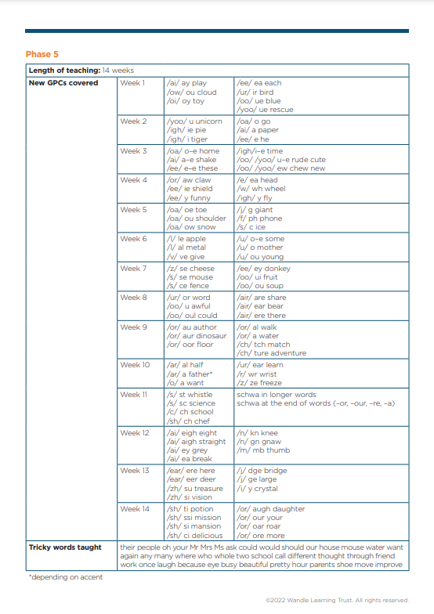
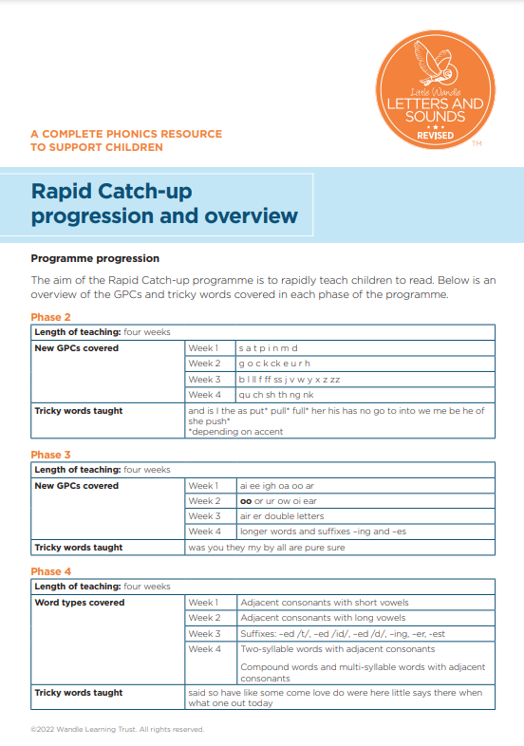
Rapid Catch-up progression
Notes:
Slide purpose:
To show the Rapid Catch-up progression
Suggested script:
Here is the progression of the programme.
Your child will be assessed so we know where to begin teaching. We will then teach the programme in this order, working our way through the whole Little Wandle Rapid Catch-up programme until your child can read fluently.
As the name suggests, we work our way through the Rapid Catch-up programme quickly, so your child can catch up as quickly as possible.

Slide 14
Timetabling
Yr3 - Five 30 minute reading sessions per week
Mon & Tues - Phonics teaching
Wed - Review day from previous lessons plus 15 minutes reading practice.
Thurs & Fri - Reading practice
Yr4 - Four 30 minute reading sessions per week
Yr5 & 6 - Three 30 minute reading sessions per week
Notes:
Slide purpose:
To show the structure of Rapid Catch-up lessons
Suggested script:
Share whether children are part of a small group or being taught one-to-one, what time their Rapid Catch-up lessons are taking place, who is teaching their lessons.

Slide 15

Reading and spelling

Slide 16
Reading and spelling
Notes:
Slide purpose:
To introduce grapheme-phoneme correspondences
Suggested script:
This is an example of what the children learn in Phase 5.
Children learn that there are graphemes that can have different sounds and sounds that can be made with different letters.
Use the backs and fronts of Phase 5 cards to show ‘ea’ and ‘ow’.

Slide 17
We will teach spelling in our phonics sessions, linking to the GPC’s. As they go through the school, we follow the scheme from Spelling Shed.
All the different ways to write the phoneme /sh/:
shell
chef
special
caption
mansion
passion
Notes:
Slide purpose:
To show the different ways of saying the sound /sh/
Suggested script:
This is an example of a sound that can be written in many different ways.
Read the words and highlight the /sh/ graphemes.
Children will learn all of these graphemes in their phonics lessons.

Slide 18
Tricky words - Tricky for a reason!
any
though
laugh
enough
sure
everyone
thought
though
does
move
although
Notes:
Slide purpose:
To introduce tricky words
Suggested script:
So, what are tricky words?
Have a look at the ‘How we teach tricky words’ video on the website: https://www.littlewandlelettersandsounds.org.uk/resources/for-parents/

Slide 19



How do we teach reading in books?
Reading practice sessions:
are timetabled three times a week.
children read the same book three times in a week .
Notes:
Slide purpose:
To introduce decodable readers
Suggested script:
The children read the same book three times in a week.
The first time we work on decoding (sounding out) the words, the second time we work on prosody which is reading with expression – making the book sound more interesting with our ‘storyteller voice’ or our ‘David Attenborough voice’, and the third time we look at comprehension.
We read the books three times at school because we want to develop the fluency. The more they see words the more they begin to read them automatically without having to sound them out.

Slide 20

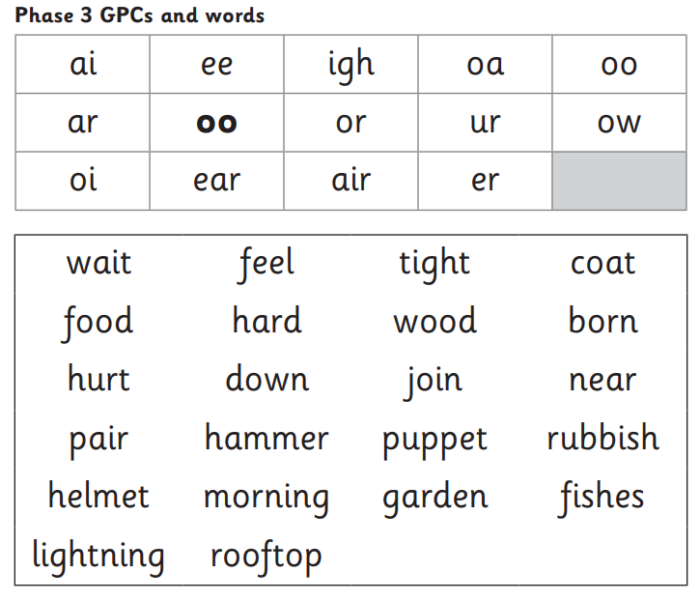


We use assessment to match your child’s reading the right level of book
Notes:
Slide purpose:
To introduce book matching
Suggested script:
We assess your child regularly to check progress.
Any child who needs extra support has Daily Keep-up sessions planned for them.

Slide 21
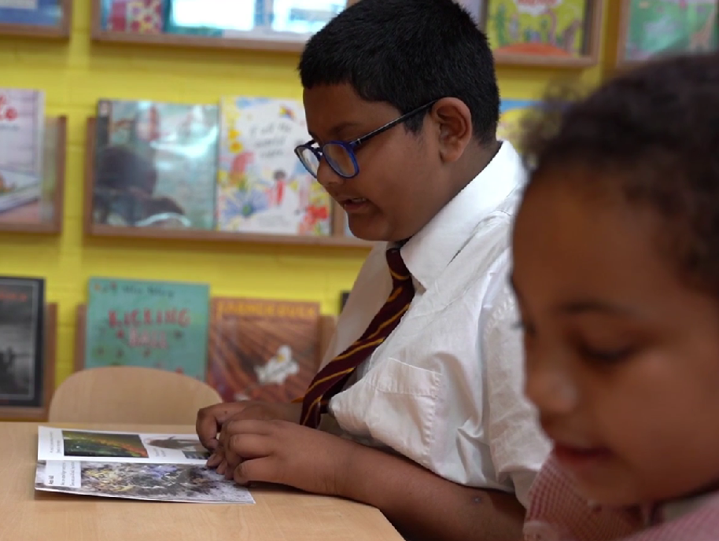
Reading a book at the right level
This means that your child should:
know all the sounds and tricky words in their phonics book well
read many of the words by silent blending (in their head) – their reading will be automatic
only need to stop and sound out about 5% of the words by the time they bring the book home – but they should be able to do this on their own.
Notes:
Slide purpose:
To provide an overview of book matching.
Suggested script:
Blending in your head means children say the sounds quietly in their heads and then read the whole word out loud. Eventually, this will become automatic and children can read words that they know fluently.

Slide 22
Aiming for fluency – this takes practice!
Speed, accuracy, prosody an expression
RCU has been designed to ensure children read the same words repeatedly. This helps moves the words into their long term memory.
Reading the same book 3 times in school and then practising this at home really helps.
Notes:
Slide purpose:
To introduce fluency
Suggested script:
We are aiming for children to become skilled, fluent readers.
Fluency is concerned with the speed in which children read, how accurate they are and their ability to read with prosody and expression.
The Rapid Catch-up programme has been designed to ensure children read the same words repeatedly over time. This helps move the words into their long term memory, and supports their reading fluency.
Reading the same book three times in school and then practising this at home really helps.
During their second read of the text, children focus on reading the text with prosody – let's take a look at this in action.
Watch the video ‘Decodable books: Read 2’ from 3.33 to 4.37. You will find the video in the Rapid Catch-up area of the website in the Reading section: https://www.littlewandlelettersandsounds.org.uk/resources/my-letters-and-sounds/weekly-reading-and-phonics/rapid-catch-up/

Slide 23
Reading at home

Slide 24
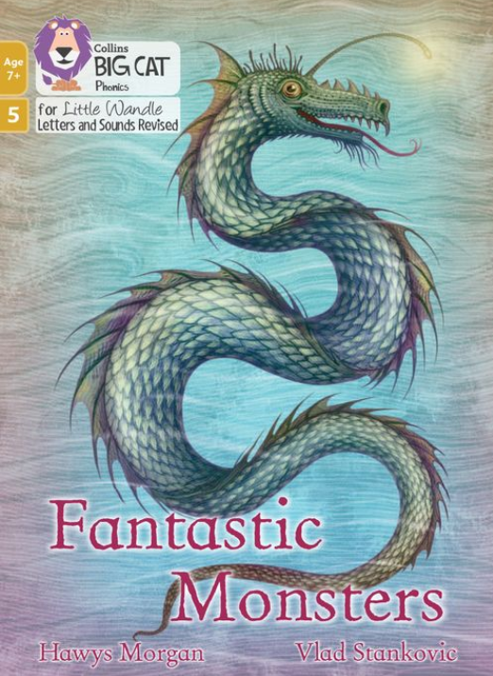
The most important thing you can do is read with your child
Reading a book and chatting had a positive impact a year later on children’s ability to…
understand words and sentences
use a wide range of vocabulary
develop listening comprehension skills.
Notes:
Slide purpose:
To introduce the values of reading at home
Suggested script:
You play a crucial part in your child's reading and the most important thing you can do is read with them.
Read the slide.
Celebrate child’s success at school.
Make time for reading at home!

Slide 25


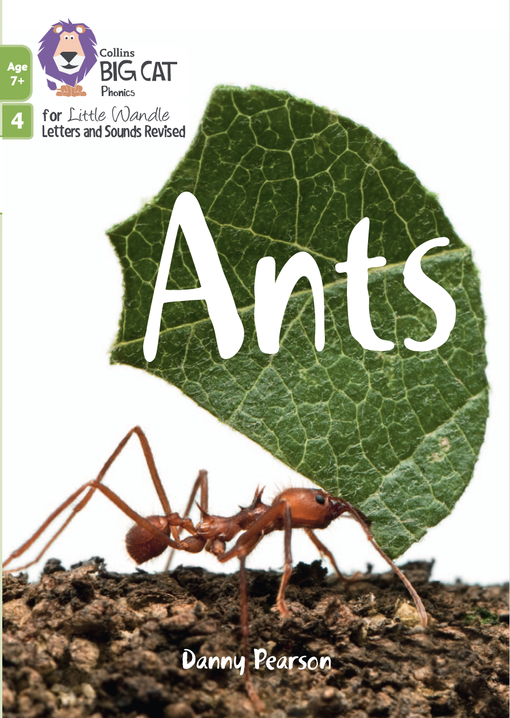




Books going home
Notes:
Slide purpose:
To summarise the format of reading at home
Suggested script:
As well as the ‘learning to read’ book that your child will bring home they will also bring home a book for sharing with you.
This book is SO important. This is how we are going to give them the WILL to read.
Please read with your child as often as you can – at least once a day if possible.

Slide 26
Listening to your child read their phonics book
Your child should be able to read their book without your help.
If they can’t read a word, read it to them.
Talk about the book when they have finished.
Notes:
Slide purpose:
To provide guidance on reading the decodable reader at home
Suggested script:
Your child will bring home their phonics book, matched to their reading ability, which they will have already read in school.
The purpose of this book is to practise their fluency.
If your child is finding a word hard to read, encourage them to sound and blend.

Slide 27
Time after time, we hear…
“This book is too easy for me!”

Slide 28


After Rapid Catch-up
Continue to support your child to become a lifelong reader.
Continue to listen to your child read.
Support them to develop their reading fluency, their prosody, and their confidence.
Notes:
Slide purpose:
To reinforce the values of reading at home
Suggested script:
Read the slide.

Slide 29
What’s coming home?
Your child will bring home:
A reading practise book
A Library book
A Reading Record (Yr3-5)
Notes:
Slide purpose:
To provide guidance on reading the shared book at home
Suggested script:
Reading to your child daily can open a variety of doors to your child's education, imagination and well-being.
Read the slide.
As a school, we also prioritise reading to the children daily to encourage the love of reading.

Slide 30
The Reading Practise book
This will be your child’s phonics book, fluency book or free reader book.
This is based on your child’s reading ability.
They should be able to read most of this book independently.
If they struggle with a word, read the word to them.
If you find they are not fluent with this book, please discuss this with your teacher.
Notes:
Slide purpose:
To provide guidance on reading the shared book at home
Suggested script:
Reading to your child daily can open a variety of doors to your child's education, imagination and well-being.
Read the slide.
As a school, we also prioritise reading to the children daily to encourage the love of reading.

Slide 31
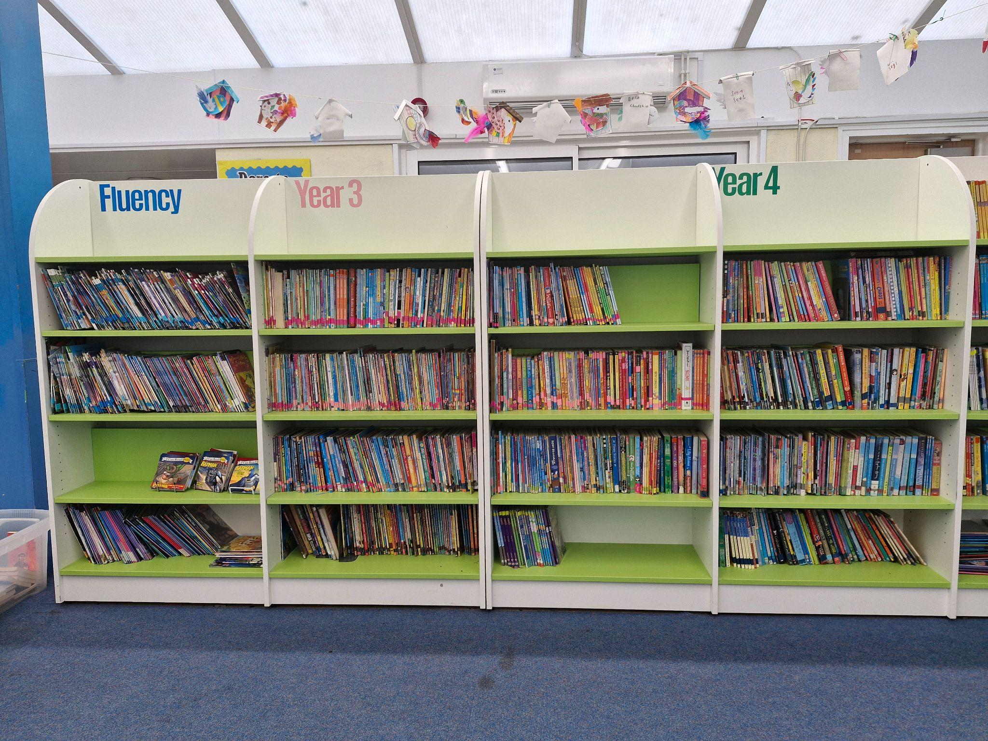
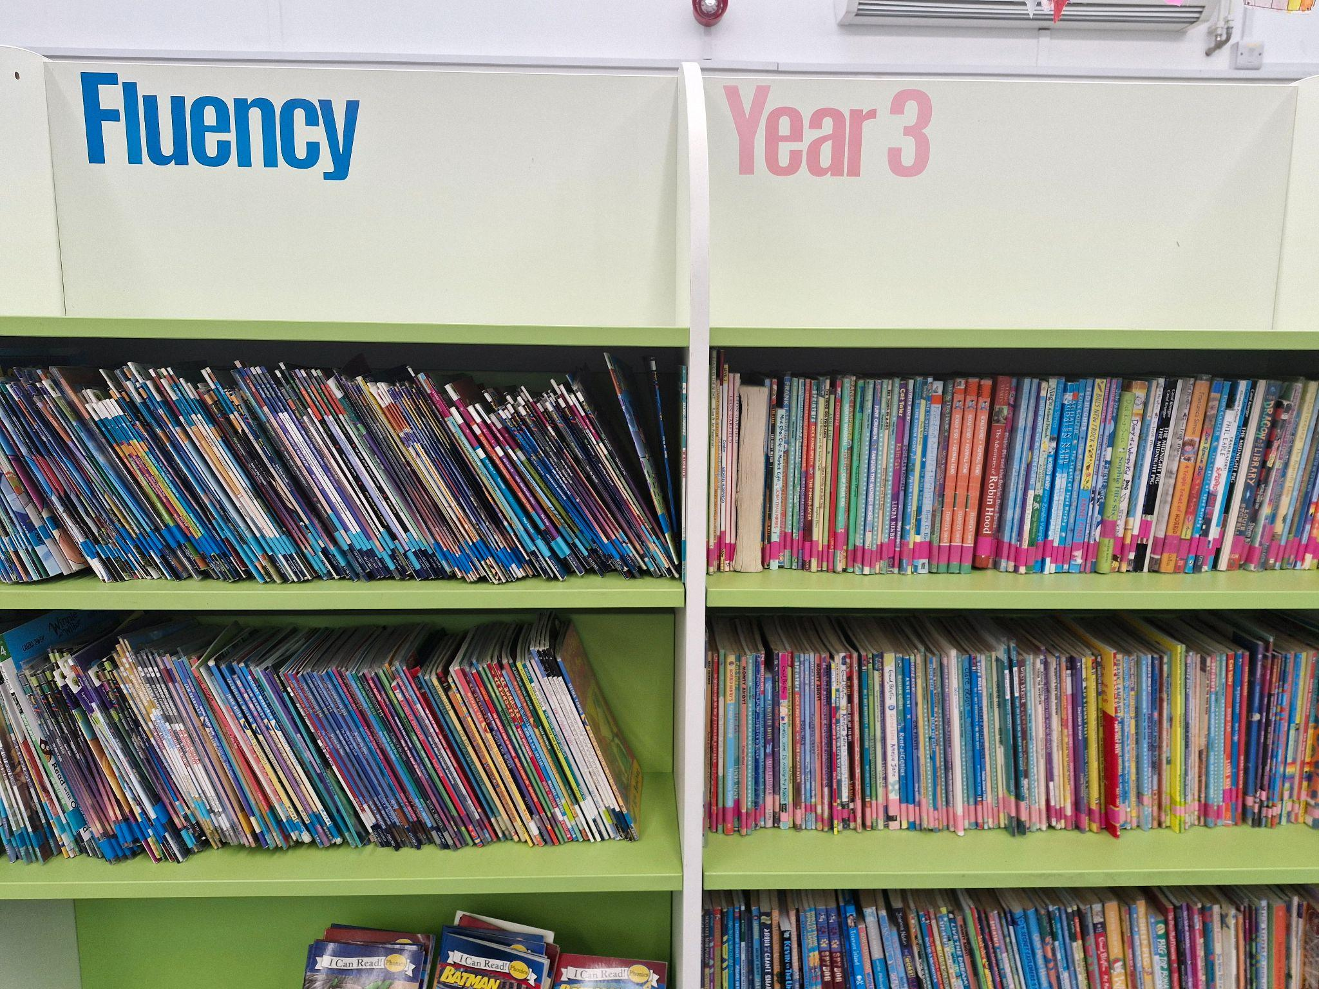
A change to our Free Readers

Slide 32
Library book
This book is for you to read with your child.
This book is for sharing and encouraging the enjoyment of reading, especially when children find reading a challenge.
Notes:
Slide purpose:
To provide guidance on reading the shared book at home
Suggested script:
Reading to your child daily can open a variety of doors to your child's education, imagination and well-being.
Read the slide.
As a school, we also prioritise reading to the children daily to encourage the love of reading.

Slide 33
The Reading Record - Years 3 - 5
This is a way for you and school to record any 1:1 reading that your child does.
Please aim for reading 5 times a week.
Record this is the reading record for your child to gain dojos when checked weekly by the teacher/TA.
Notes:
Slide purpose:
To provide guidance on reading the shared book at home
Suggested script:
Reading to your child daily can open a variety of doors to your child's education, imagination and well-being.
Read the slide.
As a school, we also prioritise reading to the children daily to encourage the love of reading.

Slide 34
Padlet - Year 6 exclusively
Starting from this September, Year 6 have been recording their reading achievements through Padlet, an online forum.
Not only is this encouraging reading and a love of books, but it is also preparing independence for secondary school.
Notes:
Slide purpose:
To provide guidance on reading the shared book at home
Suggested script:
Reading to your child daily can open a variety of doors to your child's education, imagination and well-being.
Read the slide.
As a school, we also prioritise reading to the children daily to encourage the love of reading.

Slide 35
One of the greatest gifts adults can give is to read to children
Carl Sagan
Notes:
Slide purpose:
Key takeaway/final message
Suggested script:
Read the quote.
Working together will ensure that your children become skilled readers.

