Slide 1
How to Apply Online for a School Place
You should read this guide, as well as the information on our website,
before you make your application.
You may find it useful to have this guide open in a separate window,
or to print yourself a copy, to refer to as you apply.
Deadline to apply: midnight on 31 October 2021

Slide 2
Before You Begin:
Before you start your application you should:
read our Moving up to Secondary School web pages.
read the Admissions Policy for each school you are interested in. You will find each school’s Admissions Policy on their website.
If you and your child live in England, you must only make one secondary school application for your child.
You must apply to your current home Local Authority if you do not live in Buckinghamshire. You can find your home Local Authority on the DirectGov website.
In your child’s application you may include schools located in other areas.
If you and your child currently live abroad (or in Northern Ireland, Scotland or Wales), and will be returning to live in Buckinghamshire, you should apply to us.
If you and your child are planning to move to Buckinghamshire, you should read the information on our website.
You must provide us with evidence before we will accept your Buckinghamshire address.

Slide 3
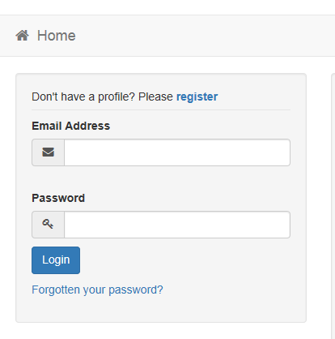
Login to the Application Portal
If you have not used the Application Portal in the last year, you must create a new profile before you can apply.
Click “Register” to create your profile.
If you have an existing profile, log in using your email address and password, then go to Page 9 in this guide.

Slide 4
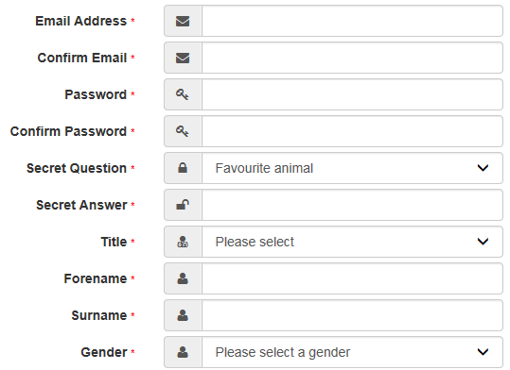
Register on the Application Portal
Enter your details in the boxes.
Your password must:
Be at least 10 characters long
Contain at least 2 numbers
Contain at least 1 lower case letter
Contain at least 1 upper case letter
Contain at least 1 special character
Not be the same as your username
IMPORTANT NOTE
The email address you use must be one you will be able to access on National Offer Day (1 March 2022): your offer email will be sent to this email address.
It should be a personal email address, not a work email address.
We may use this email address to contact you if we have any questions about your child’s application.
You should write down your email address, password, and secret question/answer, and keep it in a safe place. You will need this in March, when you log back in to the Portal to view your child’s school place offer.

Slide 5
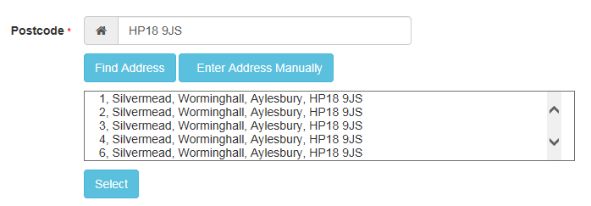
Register on the Application Portal
Enter your postcode, then click “Find Address”.
Select your address from the list that appears below.
If your address does not appear, click “Enter Address Manually” and type in your address.

Slide 6
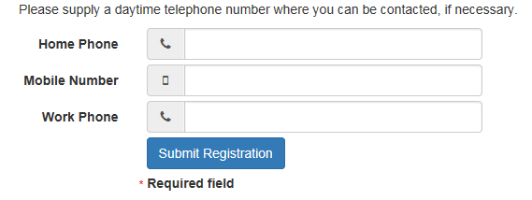
Register on the Application Portal
Next, enter your contact telephone number/s.
We may use these telephone numbers to contact you if we have questions about your child’s application.
Finally, click “Submit Registration” and you will see the message shown below:

Slide 7
Register on the Application Portal
We will now send you an email confirmation that looks like this:
The email may take up to 15 minutes to arrive. If you cannot find the email, check your junk or spam folder.
If your email does not arrive, please contact us.
Click on the link in your email, or copy and paste it into your internet browser then press ‘enter’.
This will complete your registration. You should do this straight away: the link will expire after 7 days. If you do not use your link before it expires, your account will be deleted, and you will need to start the registration process again from the beginning.

Slide 8
Register on the Application Portal
When you click on the link in your email, you will be taken to the Application Portal.
You will see this message:
Click “Home” to continue to the Portal home page.
You can now log in and start your child’s application.

Slide 9
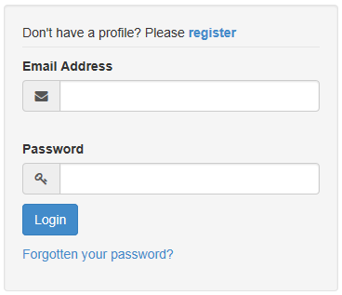
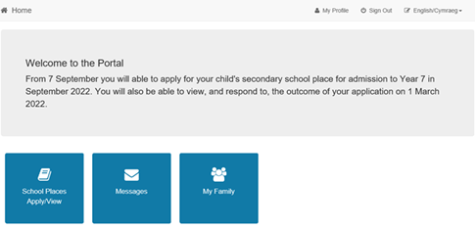
Login to the Application Portal
Enter your username and password, and click “Login”.
When you log in, you will see the home page.
To start the application process, click “School Places Apply/View”.

Slide 10
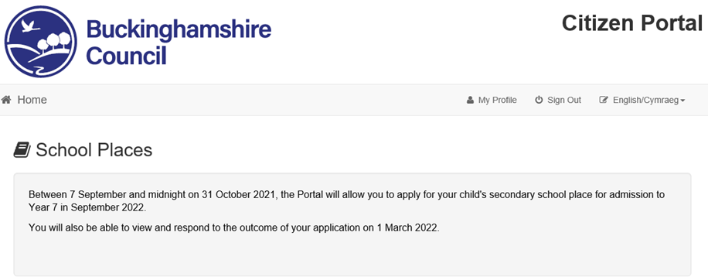
Secondary School Application: Add Child
To begin, click “Add Child”.

Slide 11
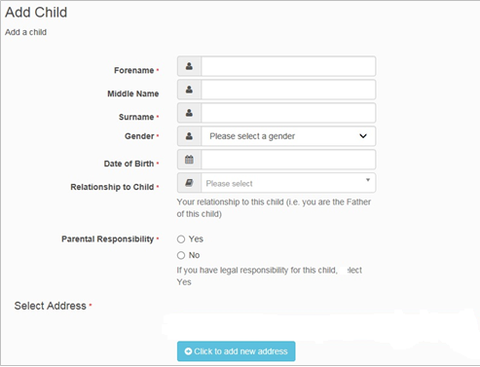
Secondary School Application: Add Child
Next, enter your child’s details.
The address you enter for your child should be their ‘Normal Home Address’. A definition of this is on our website.
If your child’s address is the same as your address, just click on the address where it is shown.
If your child lives at a different address, “Click to add new address”. You should then contact us to explain why your child lives at a different address. Please also see the note below.
When you have finished, click “Add child”.
IMPORTANT NOTE:
If you are a split family and your child lives between two addresses, the parent with whom the child spends most of the school week should make the application. You should read the information about shared/joint residence on our website before you apply. You must have permission from the other parent or carer, and you both must agree on the preferences (and order) before you submit the application.

Slide 12
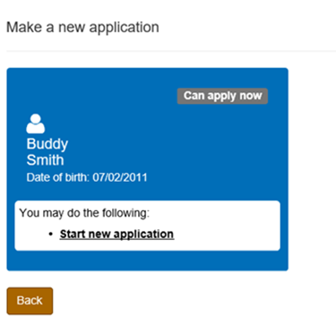
Secondary School Application: Start Your Application
Now that you have added your child’s details, you can start their secondary school application.
To begin, click “Start new application”

Slide 13
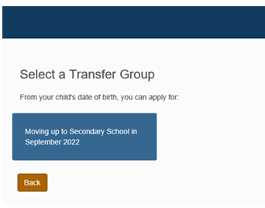
Secondary School Application: Select the application you want to make
Click on the blue tile – “Moving up to Secondary School in September 2022”
IMPORTANT NOTE
If your child is in Year 6 but was not born between 01/09/2010 and 31/08/2011, you will not be able to apply online for your child’s secondary school place.
Please contact us for information about how to make your application.

Slide 14
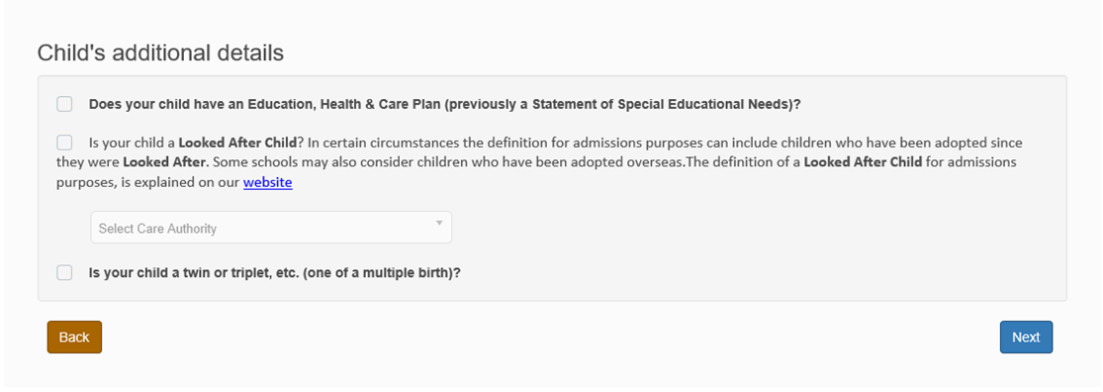
Secondary School Application: Important information about your child
Tick the box (or boxes) if your child:
has an Education, Health and Care Plan (previously a Statement of Special Educational Needs);
is a ‘Looked After Child’ (currently or previously in Public Care – see definition on our website);
is a twin or triplet (or other multiple birth sibling).
Click “Next” when you have finished.

Slide 15
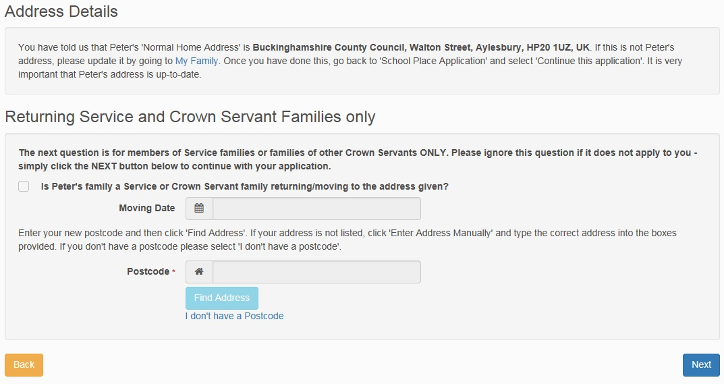
Secondary School Application: Confirm your child’s address
Check that this is your child’s Normal Home Address (see definition on our website).
Only complete this section if you are a Returning Service or Crown Servant family.

Slide 16
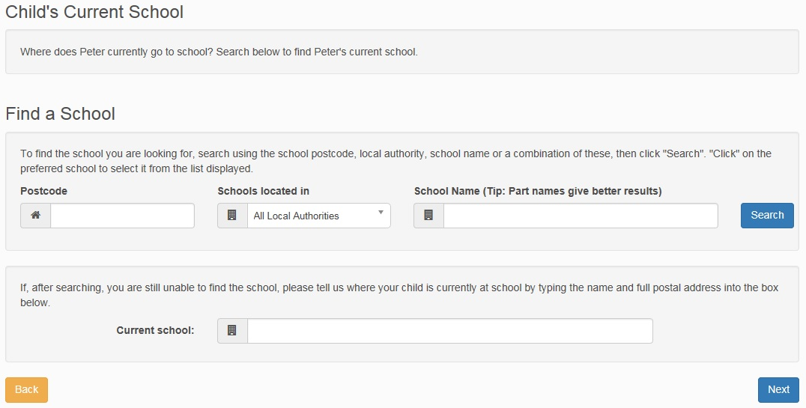
Secondary School Application: Add your child’s school
Tell us where your child currently goes to school.
Use the three boxes here to search for your child’s school – an example is given on the next page.
If you can’t find your child’s school, type the school’s name, and town or postcode, in the box provided.
E.g. “St Joseph’s, Thame”

Slide 17
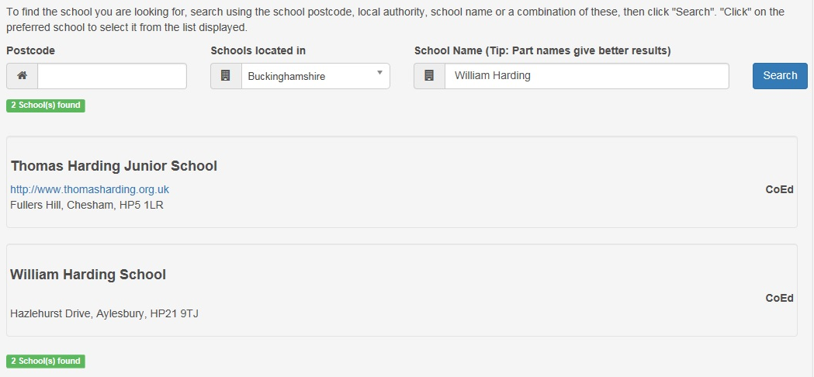
Secondary School Application: Add your child’s school
EXAMPLE: Search for William Harding School
Leave the ‘Postcode’ box blank.
Select “Buckinghamshire” in the middle box, because William Harding School is in Buckinghamshire.
Type part of the school’s name into the ‘School Name’ box (e.g. “William Harding” for William Harding School), and click “Search”.
Your search results will display underneath.
Click on your child’s school from the list.

Slide 18
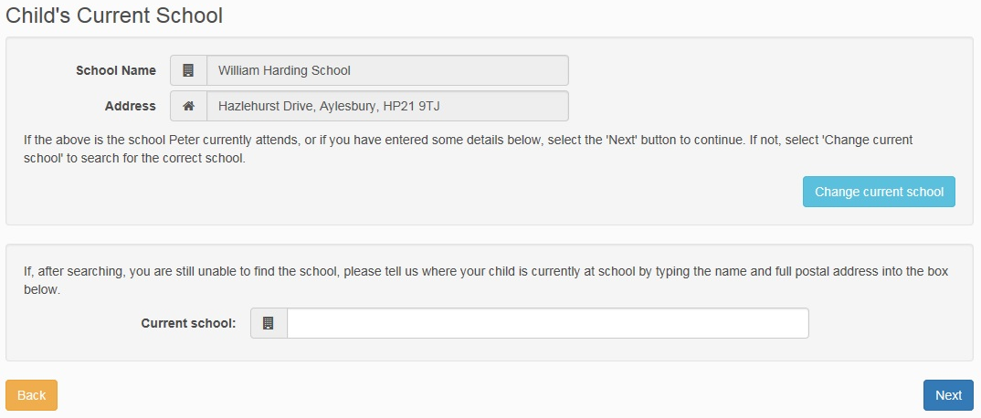
Secondary School Application: Add your child’s school
Check that the details are correct, then click “Next” to continue.

Slide 19
Secondary School Application: Select your child’s preference schools
Read this information carefully.
We have included links to our web pages that you should find helpful.
Read our Moving up to Secondary School web pages before you apply.

Slide 20
Secondary School Application: Select your child’s preference schools
Now, add your preferred school (or schools) to your child’s application.
Use the search boxes here to look for the school(s) you wish to add
(an example is given in the following pages):

Slide 21
Secondary School Application: Select your child’s preference schools
Example: search for Holmer Green Senior School
Use the “Postcode”, “Schools Located In” and “School Name” boxes to search for your preferred school. In this example, Holmer Green Senior School is the preferred school.
Select ‘Buckinghamshire’ as the area the school is located in, and type “holmer” into the “School Name” box.
Click “Search”, then click on “Holmer Green Senior School” to select it from the list.

Slide 22
Secondary School Application: Example: The Mandeville School
This guide will now show you how to add a school to your application: we have chosen The Mandeville School for this example.
In this example, “Buckinghamshire” has been selected in the “Schools located in” menu, and “mandeville” has been typed into the “School Name” box, to search for The Mandeville School.
Click “Search” and click on the preferred school (as indicated below) to select it from the list.

Slide 23
Secondary School Application: Example: The Mandeville School
Tell us if your child has a brother or sister who already attends the school.
If they do, click in the tick-box and click then “Next”. You can enter the sibling’s details on the next page.
If they do not have a sibling, leave the tick-box blank, then click “Next” and go to page 26 in this guide.

Slide 24
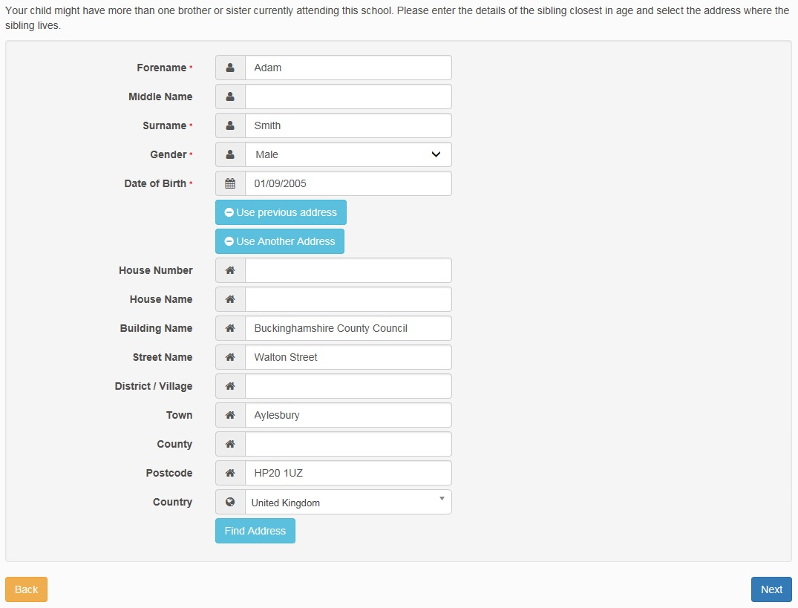
Secondary School Application: Example: The Mandeville School
If your child does have a brother or sister who attends the school:
Enter the sibling’s details here.
If your child has more than one sibling already attending the school, enter the details of the youngest of those siblings.
For example, if your child has a sibling in both Year 8 and Year 10 at the preferred school, you should only enter the details of the child in Year 8.
When you have finished, click “Next”.

Slide 25
Secondary School Application: Example: The Mandeville School
Confirm the details are correct, then click “Next”.

Slide 26
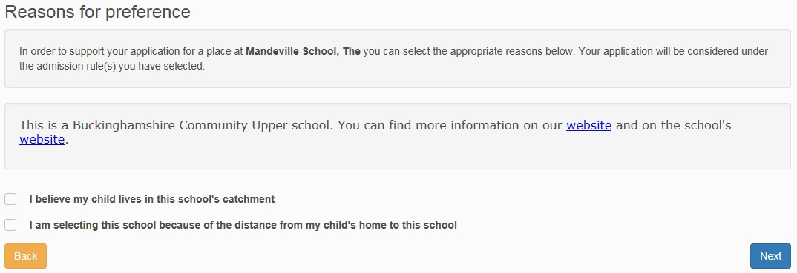
Secondary School Application: Example: The Mandeville School
Now, you should tell us the reasons for your preference.
Read the information on this page carefully, as there may be important information specific to the school.
On this page, you will also be told if the school has a Supplementary Form that you might need to fill in.
Click “Next” when you have completed the information on this page.

Slide 27
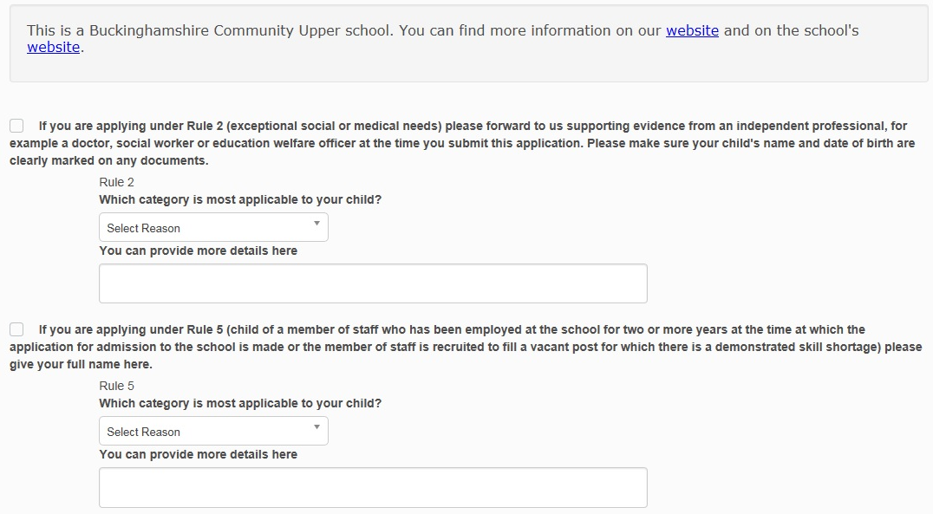
Secondary School Application: Example: The Mandeville School
Tell us if you are applying under any “Special Rules” the school may have, for example:
exceptional medical or social needs (evidence required – please Contact Us to provide the information);
children of members of staff;
attendance at feeder schools;
brothers or sisters at a linked school;
Free School Meals or Pupil Premium entitlement (evidence required – please send evidence directly to your preferred school/s).
When you have finished, click “Next”.
Important Note:
Not every school has the same rules: the ‘Special Reasons’ you see on your application may be different from those shown in this example.
Each school’s Admission Rules can be found in their Admissions Policy. You will be able to find a copy of each school’s Admissions Policy on their website.

Slide 28
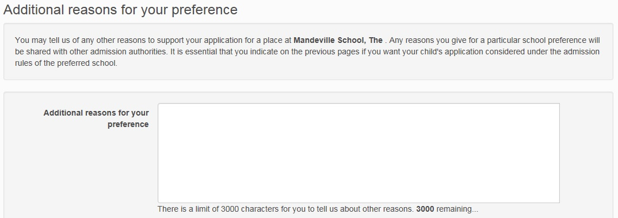
Secondary School Application: Example: The Mandeville School
Finally, you have the option to enter any additional details.
When you have finished, click “Next”.
Important Note:
Any information you choose to put here will be recorded against your child’s application, but will not be read in detail.
You must tell us on the previous pages if you want your child’s application considered under a particular admission rule/rules for the preferred school, and provide independent supporting evidence as necessary.
You may leave this section blank if you have no further information to add: most parents do not record information here.

Slide 29
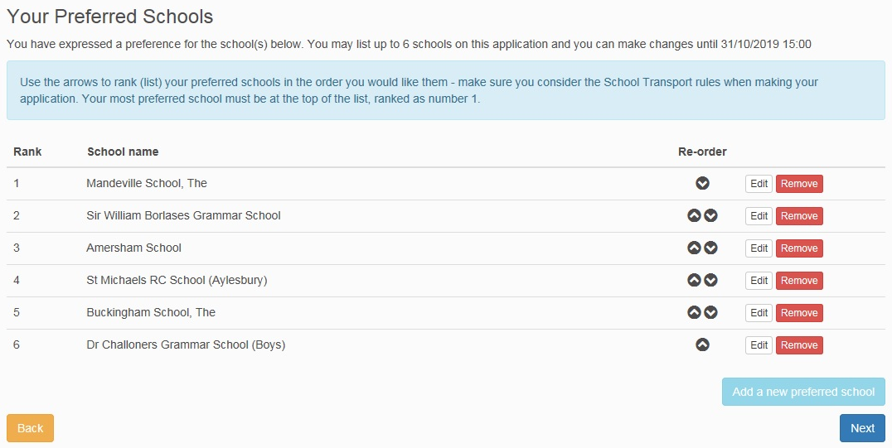
Secondary School Application: Your child’s preference schools
You can now see the preferences you have selected.
You can add further preferences (up to six in total) by clicking:
If you would like to edit or remove a preference, click or
If you would like to change your preference order, use the arrows:
When you have finished adding schools to your child’s application, and you are happy they are in your preferred order, click “Next”.
Important Note:
It is important to list the schools in the order you really want them. The school you most want your child to go to should be number 1, followed by your next best school at number 2, and so on.
Read the information on our website about getting the order of your preferences right.

Slide 30
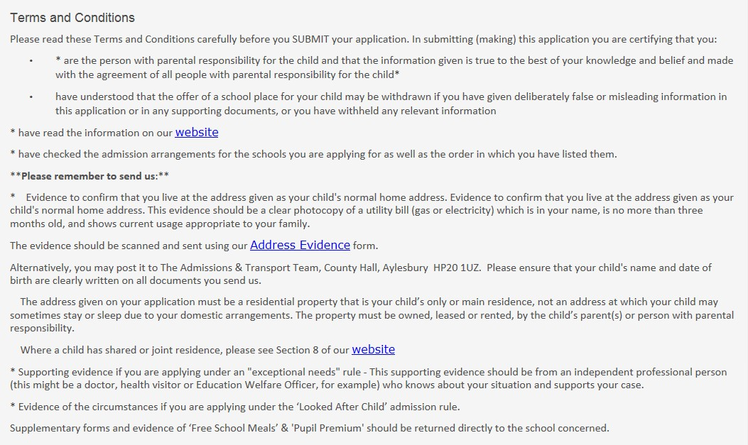
Secondary School Application: Terms and Conditions
Terms and Conditions: you must read this information carefully.
Make sure you understand it before you submit your application.

Slide 31
Secondary School Application: Data Protection
Data Protection: you must read this information carefully.
Make sure you understand it before you submit your application.

Slide 32
Secondary School Application: Submitting your application
School Place Offer: you must tick the box against this statement – “I would like to receive my offer of a school place via email”
We will not post your child’s school offer to you.
All online applicants will receive their child’s school place offer by email, and you will also be able to log in and respond to the offer from 1 March.

Slide 33
Secondary School Application: Submitting your application
If you would like to preview your application before you submit it, click “Preview”.
You must tick this box to confirm you have read and understood the Terms and Conditions.
When you have finished, click “Submit Now”.
We strongly recommend you “Submit Now” rather than “Return Later”. If you press “Submit Now”, you will still be able to log back in to your application until the deadline to make changes.
Remember the application deadline: midnight on 31 October 2021

Slide 34
Secondary School Application: Your application is submitted
You have now submitted your application.
You can preview your application by clicking “Preview”.
If you need to make changes you can log back in to the application until 3pm on 31 October 2021 – see page 36 onwards for further information. If you need to make changes later, you must remember to re-submit your application when you’ve finished, otherwise your application will be lost.
You will now receive an email to confirm your application has been submitted – please check your inbox to make sure this has arrived, and make sure you keep this email safe.

Slide 35
What Should I Do Now?
Address Evidence
If you have not uploaded evidence of your child’s Normal Home Address, you must send this to us. This should be a recent utility bill (gas or electricity). Visit www.buckinghamshire.gov.uk/contactadmissions to upload your evidence. You cannot currently post a paper copy to us.
Supplementary Information Forms (SIFs)
All Supplementary Information Forms (SIFs) should be sent directly to the school – check their websites for more information.
Dr Challoner’s Grammar School – SIF required if you want your child considered under the ‘Catchment’ rule.
Dr Challoner’s High School – SIF required if you want your child considered under the ‘Catchment’ rule.
Khalsa Secondary Academy - SIF required if you want your child considered under a faith rule.
St Michael’s Catholic School (High Wycombe OR Aylesbury) - SIF required if you want your child considered under a faith rule.
The Royal Grammar School – SIF required if you want your child considered under the ‘Catchment’ rule.
Waddesdon Church of England School – Church Affiliation Form required if you want your child considered under a faith rule.
If you are applying for a school (or schools) in other areas, check their websites to see if you need to complete a supplementary form.
Other supporting evidence
If you have not uploaded it, you need to provide evidence if you are applying under a special rule (e.g. Free School Meals, looked-after child, exceptional medical/social reasons). Check if evidence should be sent to the Admissions and Transport Team or the school, and then send it as soon as possible.
Exceptional Medical/Social Reasons: further information about this rule and what evidence you need to provide can be found on our website.

Slide 36
What if I want to make changes to my application?
You can make changes up to the deadline: midnight on 31 October 2021
IMPORTANT: as soon as you click on “Change Application”, your application will become UNSUBMITTED.
An unsubmitted application cannot be processed.
If you do not click “Submit” before the deadline of midnight on 31 October, your application will be lost. This is likely to significantly impact the chance of your child being offered a preferred school.
If your application is unsubmitted, you will receive automatic emails reminding you to “submit” as the deadline (midnight on 31 October) approaches.
To submit your application if it is unsubmitted:
Login to the online portal
Click “Apply for a school place”
Find your child, and click “continue application”
Continue through the pages of your application by clicking “next” until you reach the final page
Select “yes” to agree to the Terms and Conditions
Click “Submit Now”

Slide 37
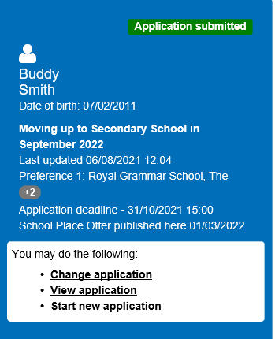
What if I want to make changes to my application?
If you have submitted your child’s application and you want to make changes, log back into the portal and click “Change application”.
If you just want to look at the application you have submitted, click “Preview Application”.
If you want to make changes, click “Continue”
If you click “continue”, your application will become unsubmitted, so you must remember to submit it before midnight on 31 October. If you do not submit it, your application will be lost.

Slide 38
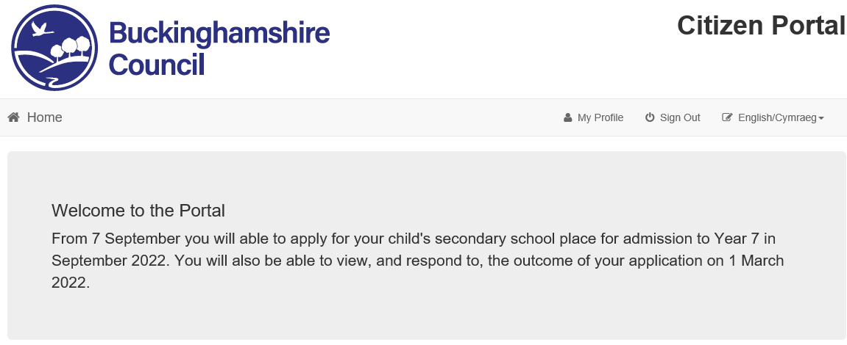
How do I change my details or my child’s details?
If you want to make changes to your child’s details, login to the Application Portal and click on “My Family”.
If you want to make changes to your personal details, login to the Application Portal and click on “My Profile”.

Slide 39
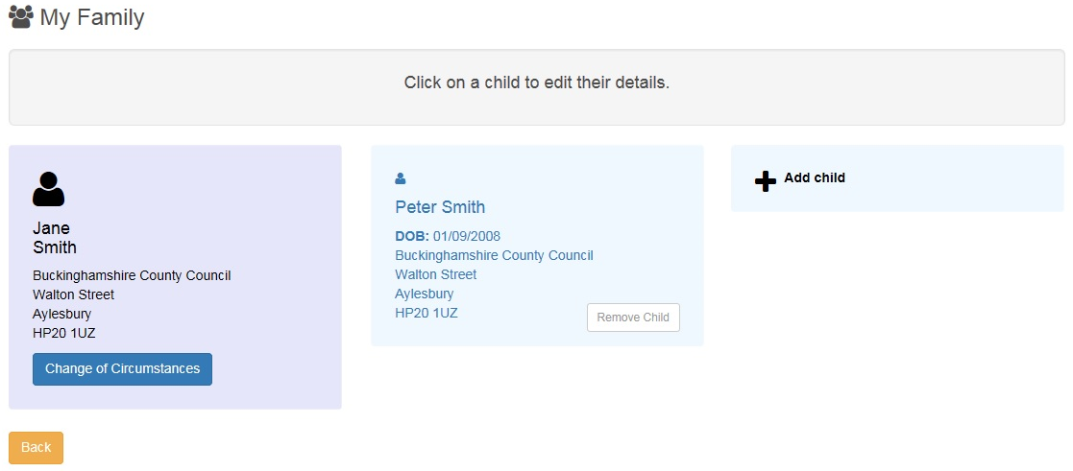
How do I change my child’s details?
Here are your details.
You cannot change your personal details here. If you want to change your personal details, follow the instructions on page 38 of this guide.
If you would like to tell us about a change of circumstances (e.g. you have moved house), click “Change of Circumstances” and follow the instructions.
Here are your child’s details.
Click on your child’s record to make any changes: instructions are on the next page.

Slide 40
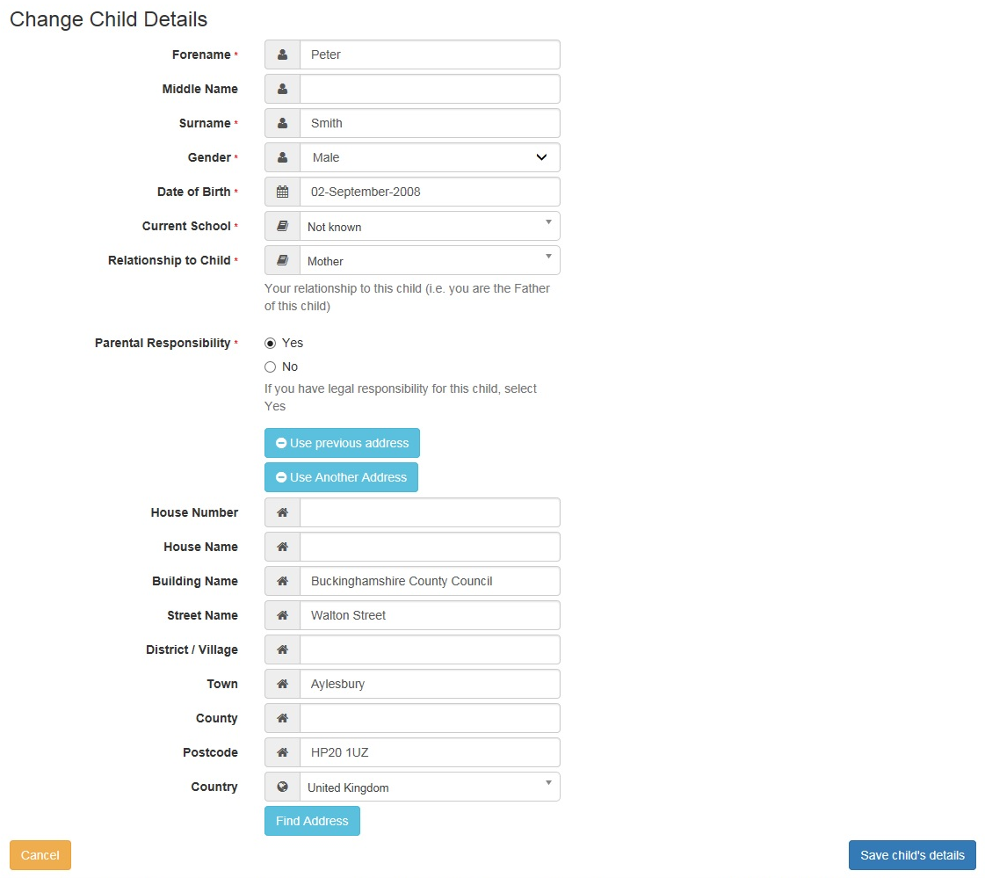
How do I change my child’s details?
Type your changes in the boxes here.
Click “Save child’s details” when you have finished.

Slide 41
How do I change my child’s details?
If you already submitted your child’s application, and you then change your child’s details, you will see one of the two messages shown below.
Read the information, then click “Continue” to return to your home page.

Slide 42
Feedback
Thank you for using our How to Apply Online guide – we hope you have found it helpful.
A guide showing you how to respond to your child’s offer will be available from National Offer Day (1 March 2022).
Please let us know if you have any feedback that would help us improve this guide. You can contact us to let us know your thoughts:
www.buckinghamshire.gov.uk/contactadmissions

